Slide 1


Phases of tissue healing
PT4050 / PT7001
Paul Starrs
P.Starrs@londonmet.ac.uk

Slide 2
CONTENTS
Review the phases of soft tissue healing
Content from today is important! Knowledge gained from today will be useful not only for this module but for many other elements of the course (and your career!) beyond this point

Slide 3
CONTENTS
Be able to define what is meant by the term ‘inflammation’, its signs and mediators
Differentiate between pathophysiology, features and fate of acute and chronic inflammation
Describe the general features of tissue healing such as regeneration and repair and the associated processes
Describe the features of healing in soft tissues

Slide 4
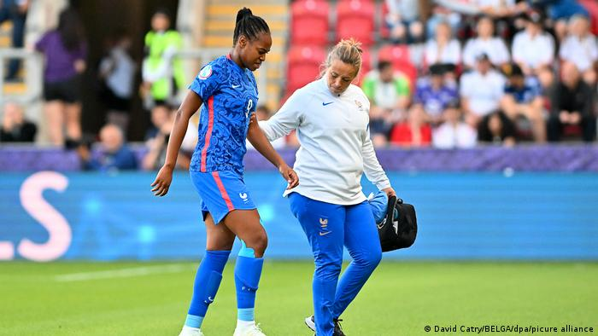
INITIATION OF TISSUE HEALING
Acute inflammation can be as a result of:
  Acute trauma
  Mechanical irritation
  Thermal insult
  Chemical insult

Slide 5
PRIMARY AND SECONDARY INJURY
Primary injury is the amount of tissue damage caused by the acute trauma – This can be increased by a continuation in aggravating activity but cannot be reduced
Secondary injury occurs from hypoxic cell death caused by the subsequent management – Can be decreased
Tissue healing refers to the body's replacement of destroyed tissue by living tissue (Walter and Israel, 1987)

Slide 6
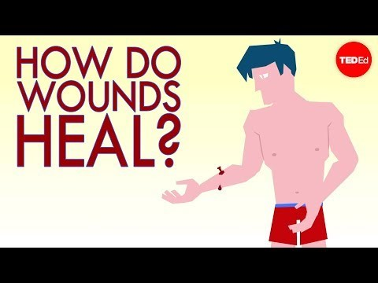
Notes:
https://www.youtube.com/watch?v=TLVwELDMDWs

Slide 7
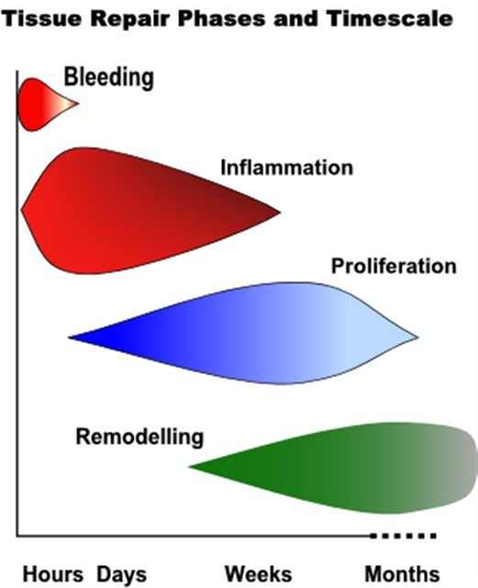

Slide 8
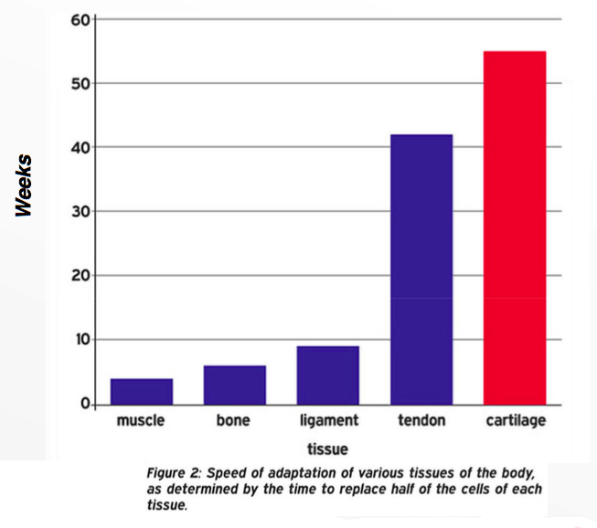
BLEEDING
Sometimes referred to as hemostasis
Relatively short lived – 4-6 hours
Duration of bleeding will vary depending on structure involved – the more vascular the tissue, the longer it will bleed but the quicker it will repair

Slide 9
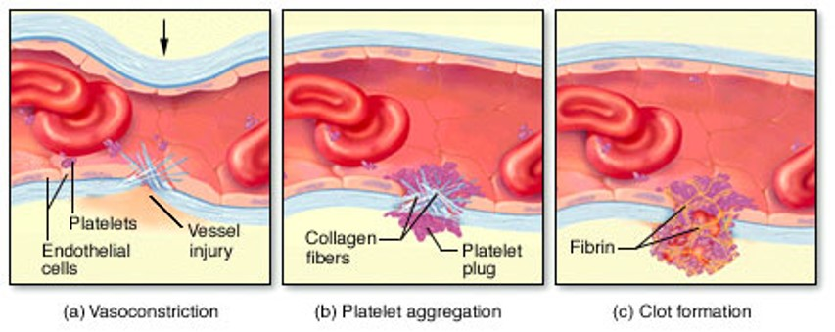
BLEEDING
Disruption of blood vessels
Immediate, but brief, vasoconstriction of local vessels to limit blood flow to area and prevent excess bleeding, followed by vasodilation once clot formed by fibrin and fibronectin

Slide 10
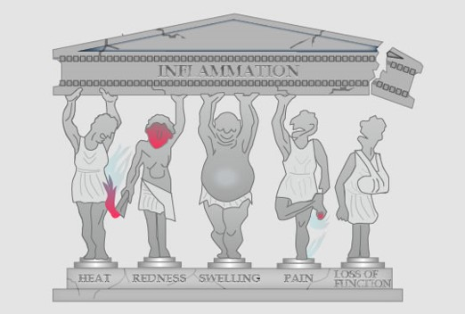
INFLAMMATION
NORMAL reaction of the body to tissue damage
Essential component, rather than inappropriate reaction, as:
  Removal of damaged and dead tissues
  Prepares body to repair
Onset and resolution are swifter in more vascular tissues and slower in the relatively poorly vascularised tissues
“-itis” is a suffix which usually indicates a condition with inflammation presence

Slide 11
CARDINAL SIGNS OF INFLAMMATION
HEAT
REDNESS
SWELLING
PAIN
LOSS OF FUNCTION
Increased chemical activity & increased blood flow to skin surface
Caused by dilation of blood vessels & increased blood flow
Caused by accumulation of blood, lymphatic fluid and damaged tissue cells
Stimulation of pain detecting nerve endings. Increase in chemical irritants
Resultant of increased pain & swelling

Slide 12
INFLAMMATION
Rapid onset after acute injury
Maximal reaction 1-3 days following
Numerous chemical mediators involved e.g. IGF, prostaglandins, growth factors, etc.
Two cascading components which occur in parallel and are significantly interlinked:
  Vascular events
  Cellular events

Slide 13
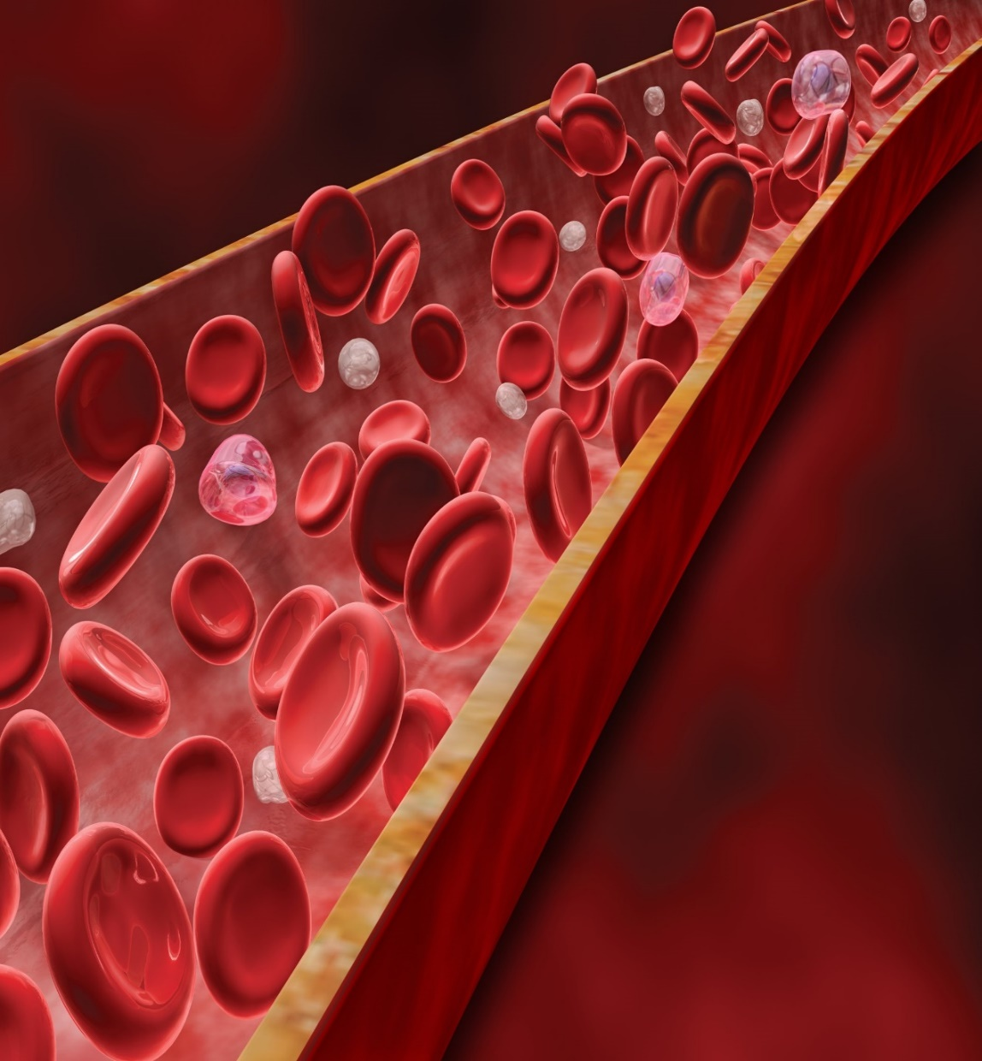
VASCULAR EVENTS
VASODILATION
An increase in VASOPERMEABILITY

Slide 14
VASCULAR EVENTS
Vasodilation follows brief period of vasoconstriction (mediated by histamine and prostaglandins)
More volume present and therefore more platelets and white blood cells migrate
Previous dormant capillaries are opened
An increase in vasopermeability is mediated by release of chemicals such as histamine and serotonin
Leakier cell membranes, increase volume, flow and pressure cause smaller solutes to pass into tissue spaces
Increase presence of plasma proteins causes an attraction, and the retention, of fluid which results in tissue oedema

Slide 15
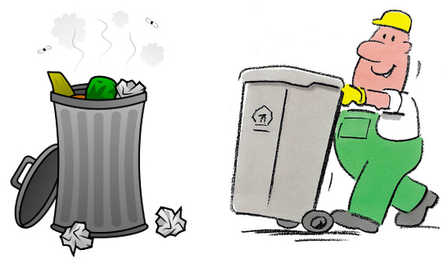
CELLULAR EVENTS
Emigration of phagocytes e.g. neurtrophils (white blood cells that fight infection and bacteria) help to protect from infection
Remove tissue debris e.g. dead/dying cells, fibrin mesh/clot, all need to be removed
As a bonus, one of the chemicals released as an end product of phagocytosis is lactic acid which is one of the stimulants of proliferation

Slide 16
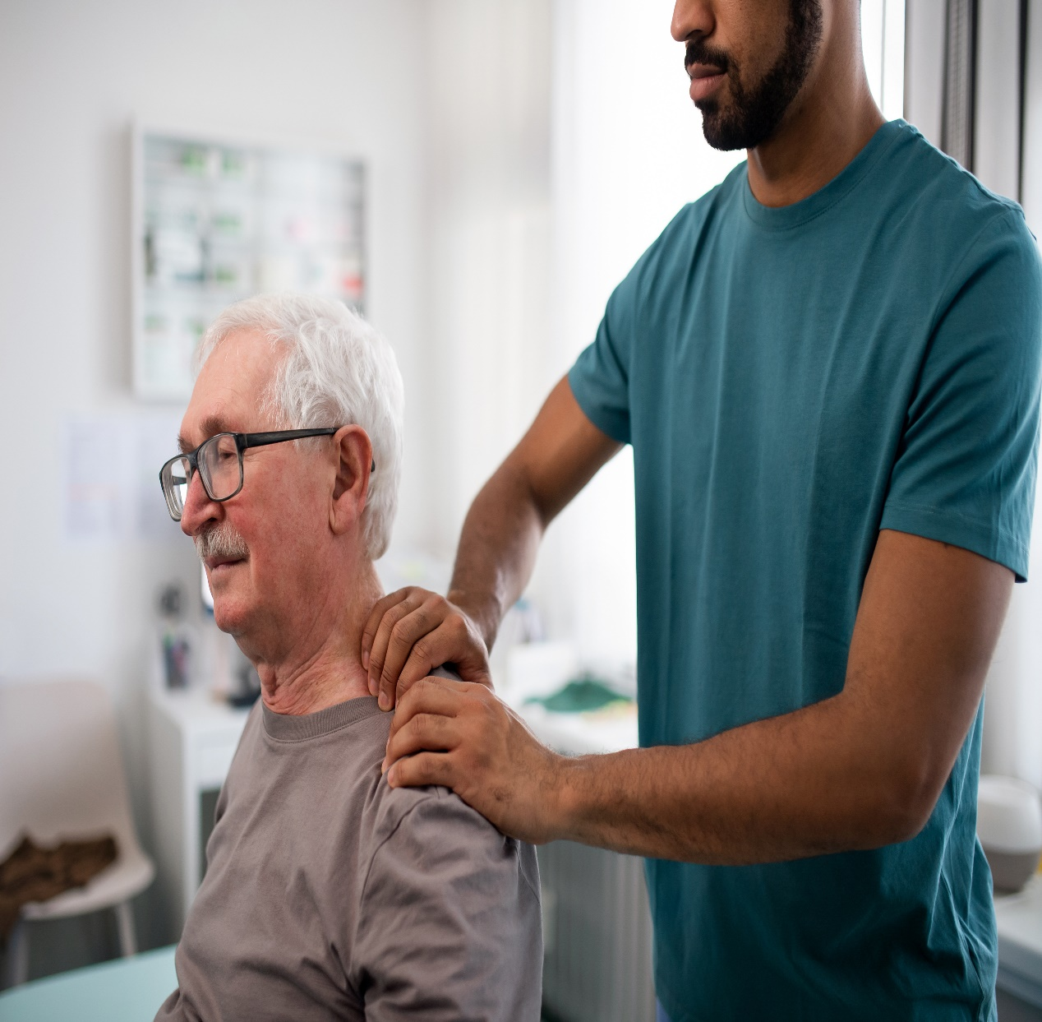
CHRONIC INFLAMMATION
May follow on from a prolonged acute inflammatory reaction or in fact develop slowly with no initial acute phase (insidious onset)
Insidious onset of inflammation may be caused by local irritants, poor circulation, some micro-organisms or immune disturbances
Usually more productive as attempting to produce fibrous material to aid repair

Slide 17

PROLIFERATION
“TO INCREASE RAPIDLY IN NUMBER”
Also referred to as the regeneration phase
Restoration of repair tissue
Extends from 48 hours to 3-6 weeks

Slide 18
PROLIFERATION
There are two processes involved in the temporary repair procedure:
    Formation of fibroblasts (fibroplasia)
    Angiogenesis

Slide 19
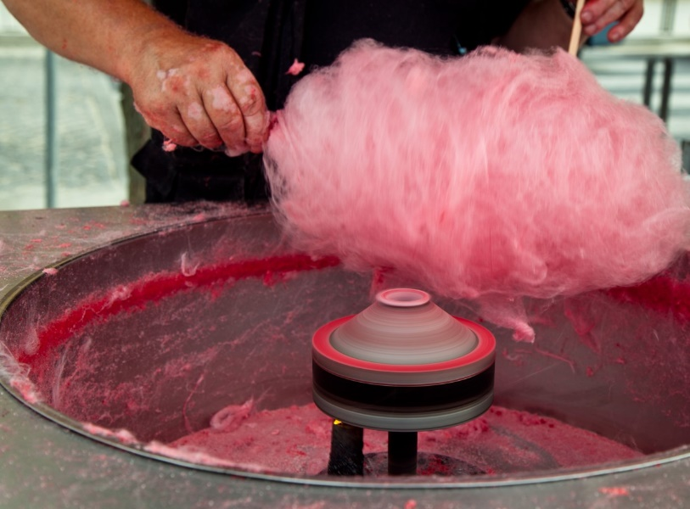
FIBROBLAST FORMATION
A fibroblast is a cell that manufactures and maintains connective tissue. In the human body, this connective tissue is called COLLAGEN
During proliferation, fibroblasts will migrate to the injured area (as a result of chemical mediators (Macrophage Derived Growth Factors) released by the macrophages during inflammation) and start to produce new collagen to replace the dead/dying tissue
Initially, type III collagen will be produced which has a granular structure

Slide 20
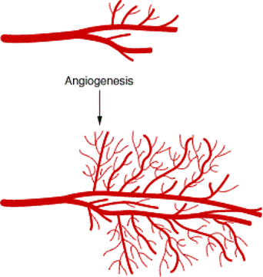
ANGIOGENESIS
LATIN FOR BLOOD VESSEL
“TO CREATE”
Capillaries bud in area to provide cells with blood which provide the oxygen required for metabolism, as well as removal of metabolic and repair waste products

Slide 21
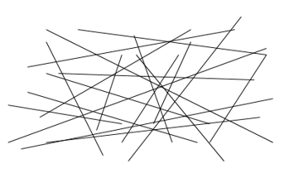
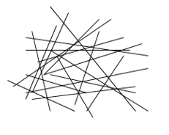
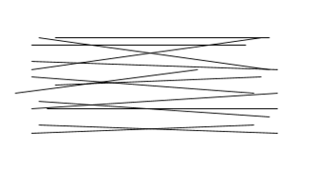
REMODELLING
Refinement of the collagen and its extracellular matrix
The initial deposition of collagen produces relatively weak fibrils with random orientation
With maturity, the collagen increases in tensile strength and is oriented in line with local stresses (tissue loading via exercise is key!)
Overall, type III collagen matures, or is reabsorbed, into type I collagen
Can last up to 12 months post injury

Slide 22
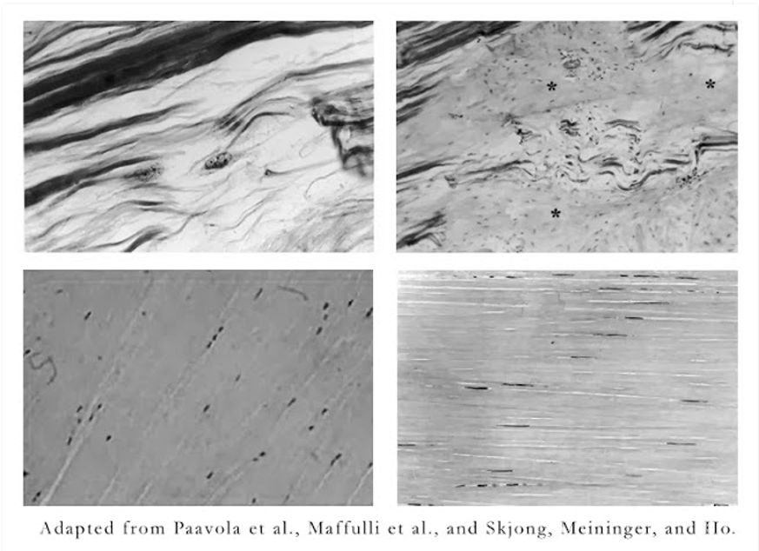
INJURED AND HEALTHY TENDON TISSUE

Slide 23
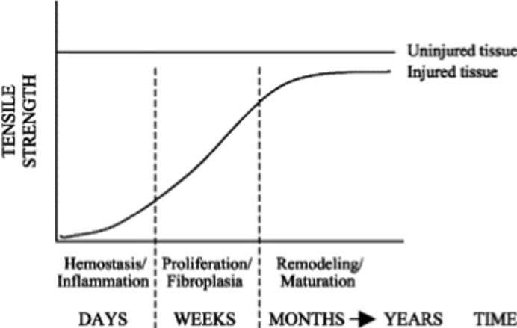
COLLAGEN STRENGTH

Slide 24
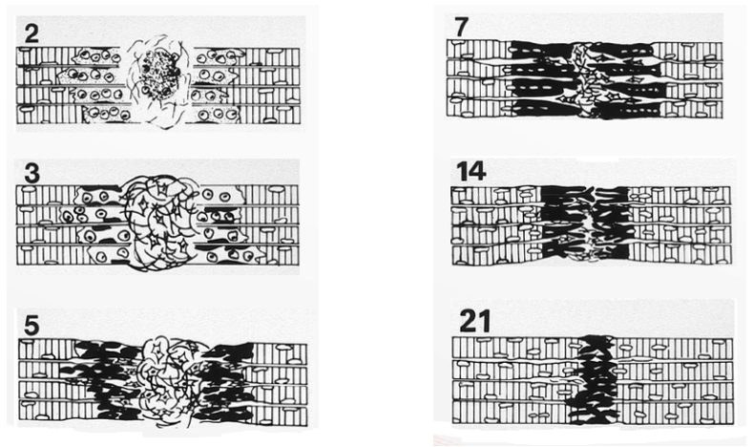
PROLIFERATION AND REMODELLING

Slide 25

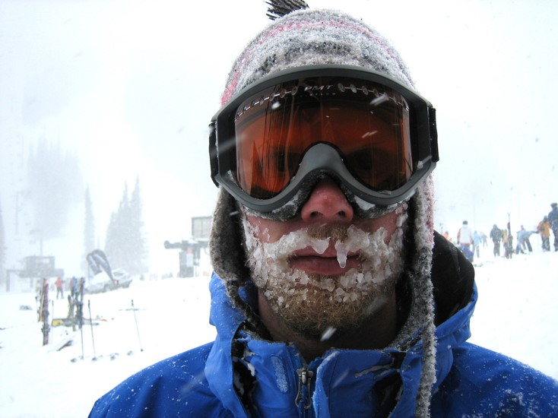
FACTORS THAT AFFECT HEALING
Age
Smoking
Long term steroid use
NSAID's
Temperature (lower rate when colder)
Poor blood supply / ischaemia
Excessive movement or mechanical stress

Slide 26
INJURY MANAGEMENT AND HEALING
Effects of treatment and exercise prescription appear to be achieved by 'stimulating' rather than 'changing' the events during healing
Inappropriate therapy at any stage is capable of inhibiting these events and therefore results in poorer tissue repair
Treatment is not guaranteed to be beneficial – you have to be mindful of the cellular and tissue events and be selective of the most appropriate and evidence based intervention at each stage

Slide 27
SUMMARY
Four phases of healing:
    Bleeding
    Inflammation
    Proliferation
    Remodelling
Inappropriate therapy at any stage is capable of inhibiting these events and therefore results in poorer tissue repair

Slide 28

ANY QUESTIONS?

